Slide 1
影片敘述之自動生成 Video caption generation
吳克駿、江昶翰

Slide 2
Outline
Repeoduce “Sequence to sequence- Video to Text” paper (but failed)
Learn to build LSTM model with tensorflow using MNIST data
Thinking about how to combine audio with video

Slide 3
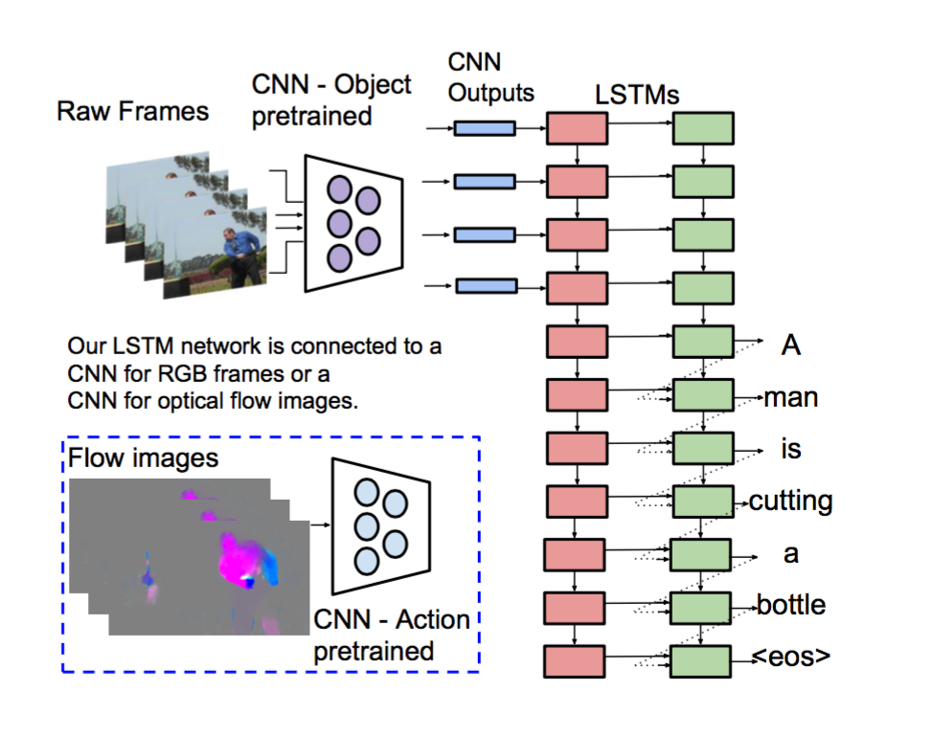
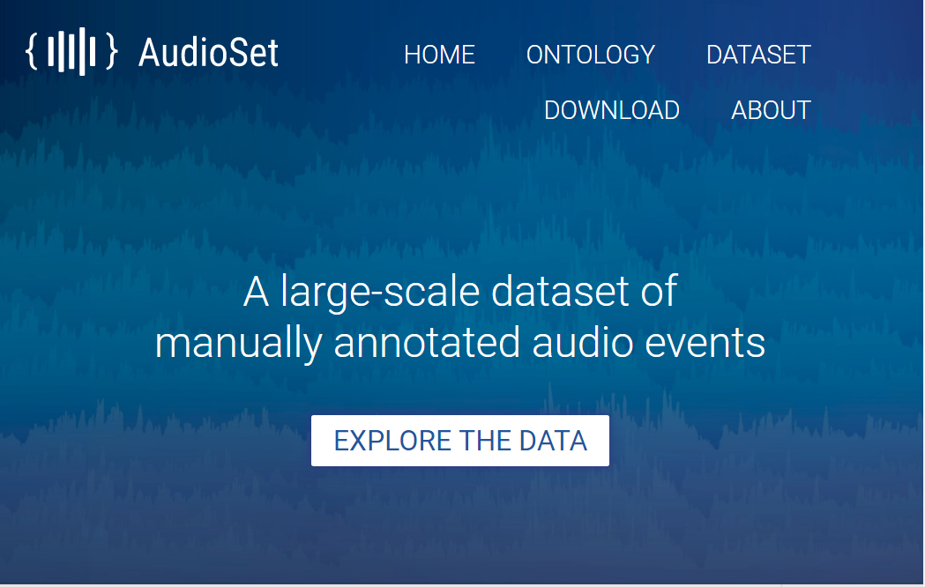
Two weeks ago….

Slide 4
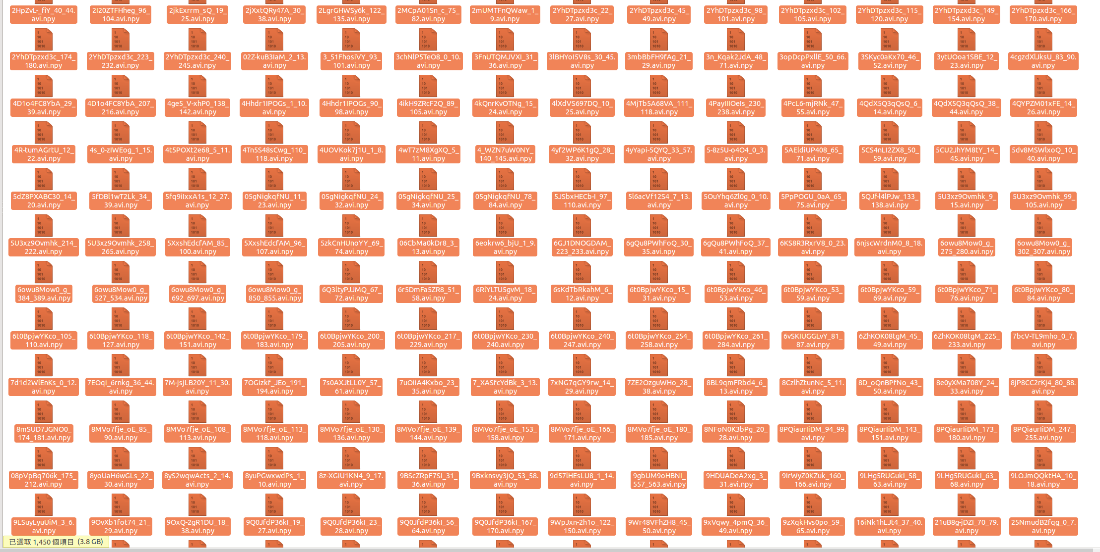
Reproduce using MLDS HW2 DATA
Which CNN features are provived
Training data: 1450 clips(.npy)

Slide 5
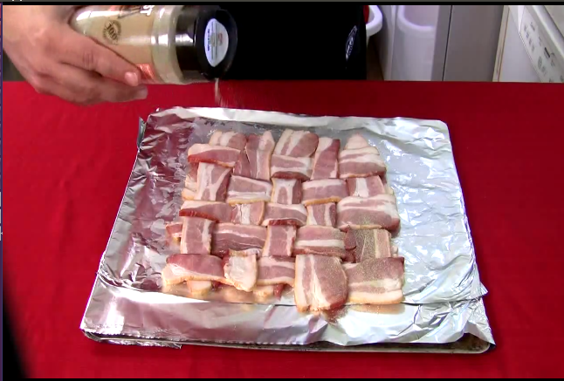
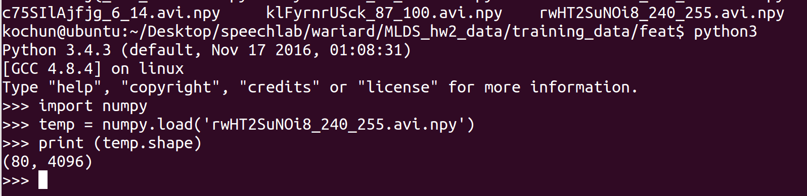
Input(one clip)
X80
CNN
64*64(maybe)
X80
80*4096
1*4096
X80

Slide 6
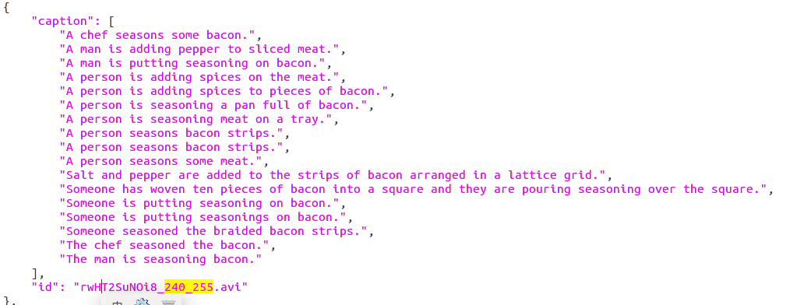
Output(one clip)

Slide 7
However…..
We need to learn LSTM with tensor flow first
Have no idea dealing with text lable
Also large scale of data

Slide 8
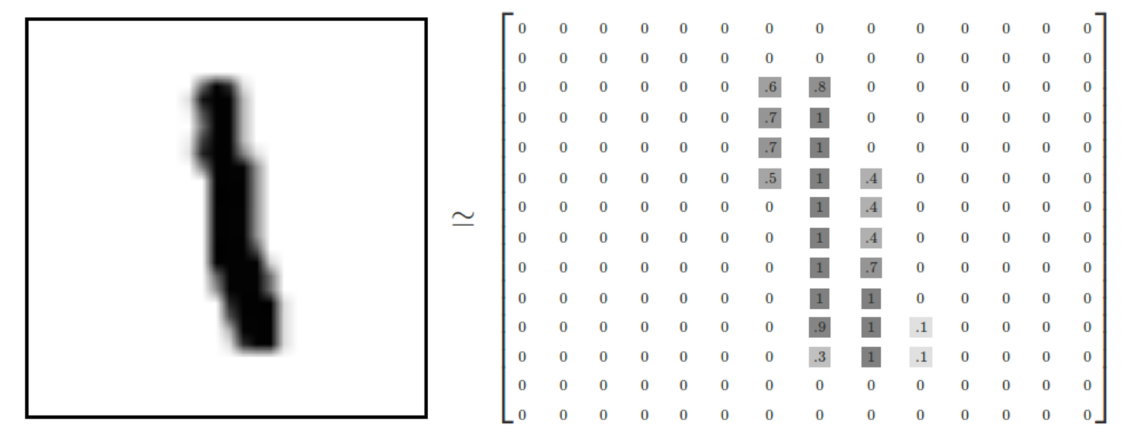
(adv.)Learning with MNIST data
Only 28*28 pixels,and with 55000 training data

Slide 9
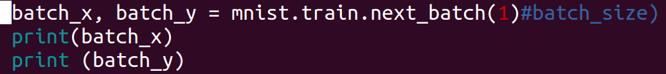
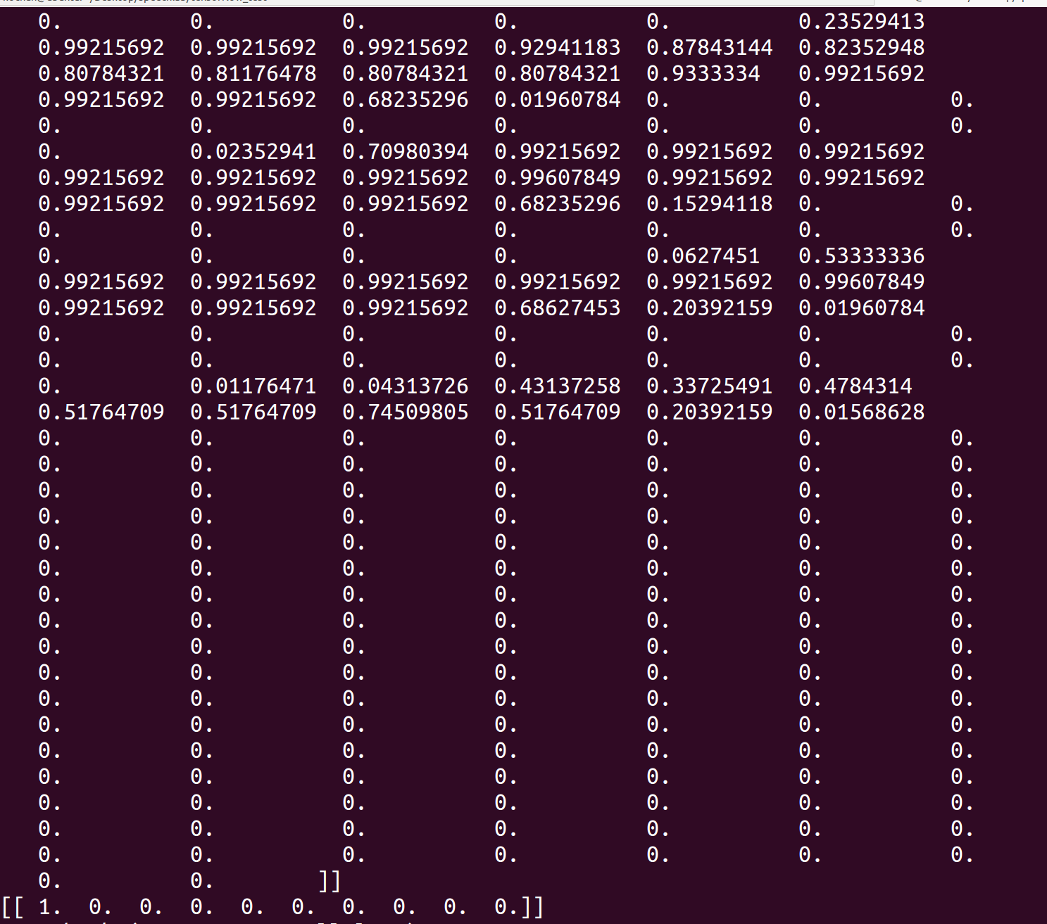
(adv.)Have functions to get the data
Features of pictures
Meaning what number

Slide 10
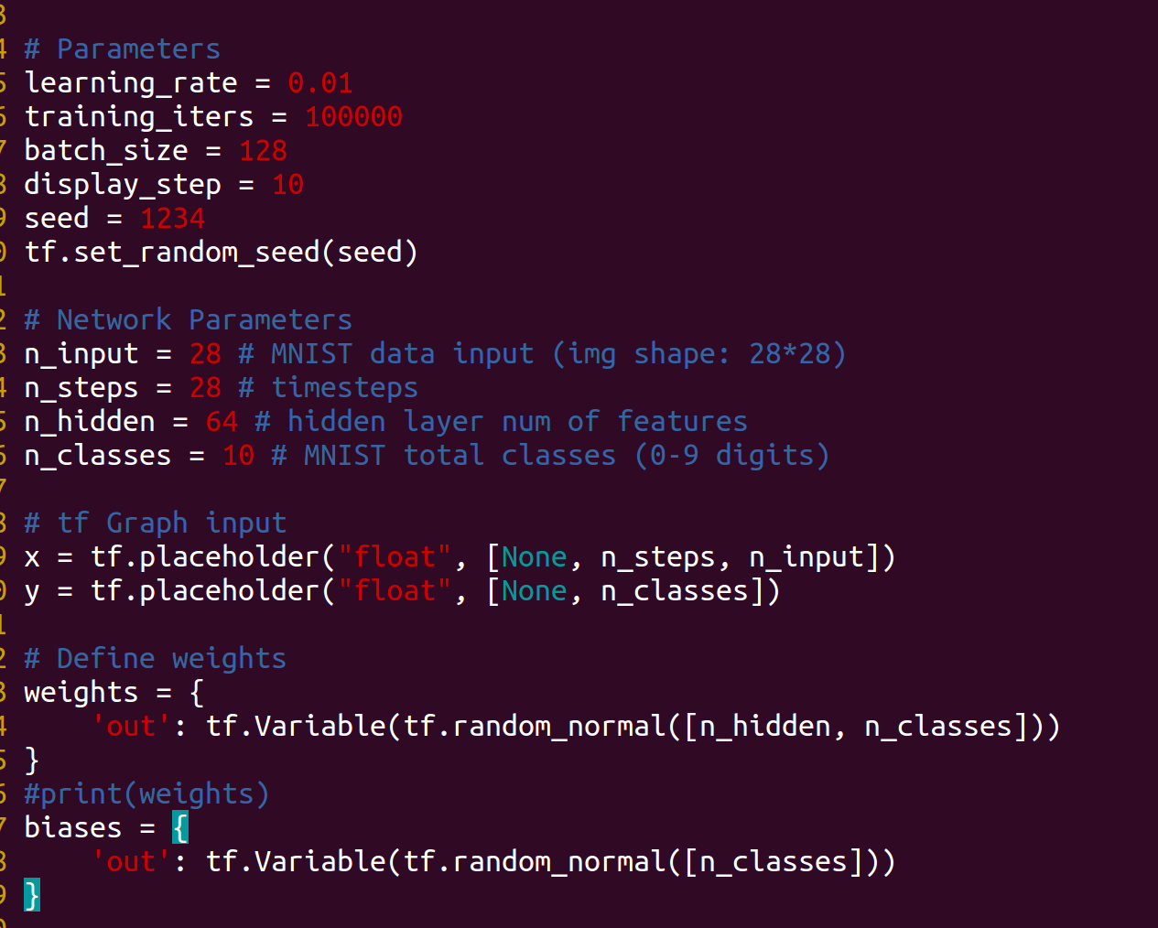
What we learn
What parameters we need?

Slide 11
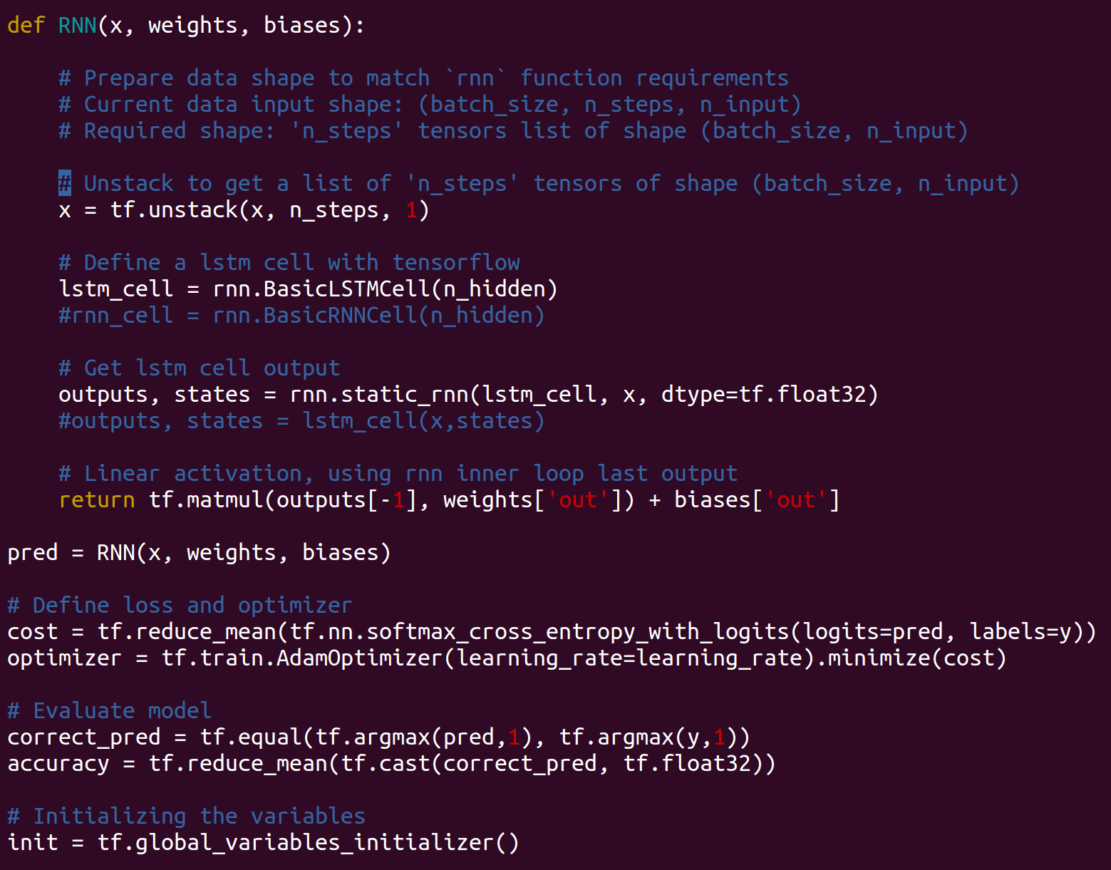
Constuct LSTM cell(Use simple linear activation)

Slide 12
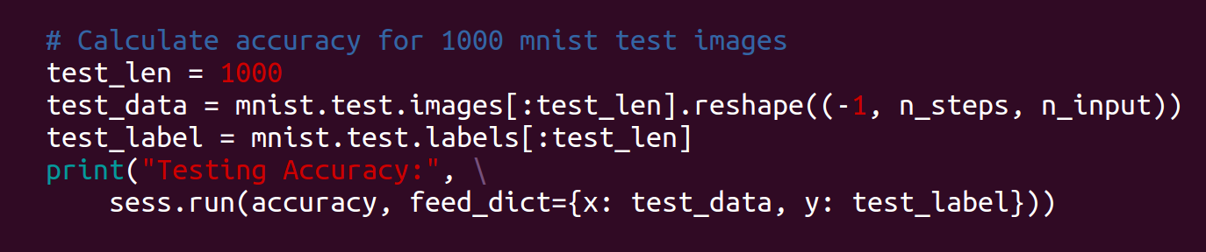
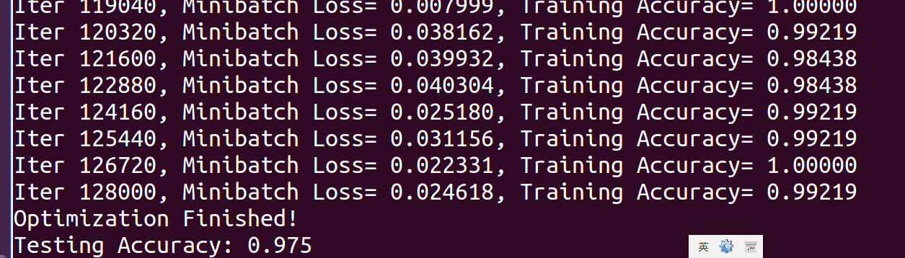
Testing
Next goal: import with our video feature data!
how to use two layer LSTM

Slide 13
Reference
RNN with MNIST
https://github.com/c1mone/Tensorflow-101/blob/master/notebooks/10_MNIST_Reccurent_Neural_Network.ipynb
Tensor flow examples
https://github.com/aymericdamien/TensorFlow-Examples/blob/master/examples/3_NeuralNetworks/recurrent_network.py

Slide 14
video caption with audio(idea)
Difficulty： 1. how to extract audio feature 2. difference between visual and audio 3. how to combine the two kinds of feature

Slide 15
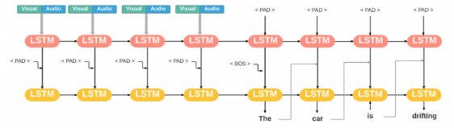
3 kinds of way
MFCC —> encode
concat after Visual

Slide 16
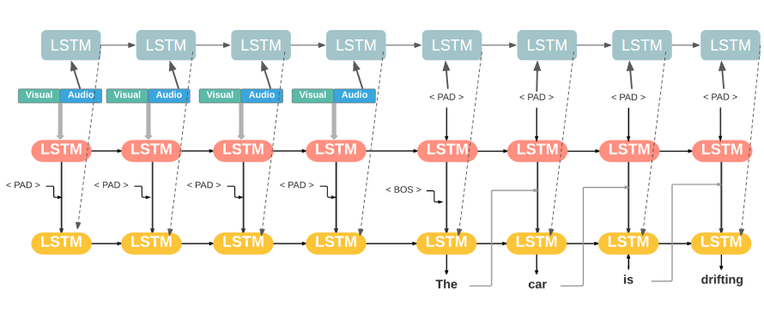
3 kinds of way
MFC —>LSTM
Visual—>LSTM and concat the output of these two

Slide 17
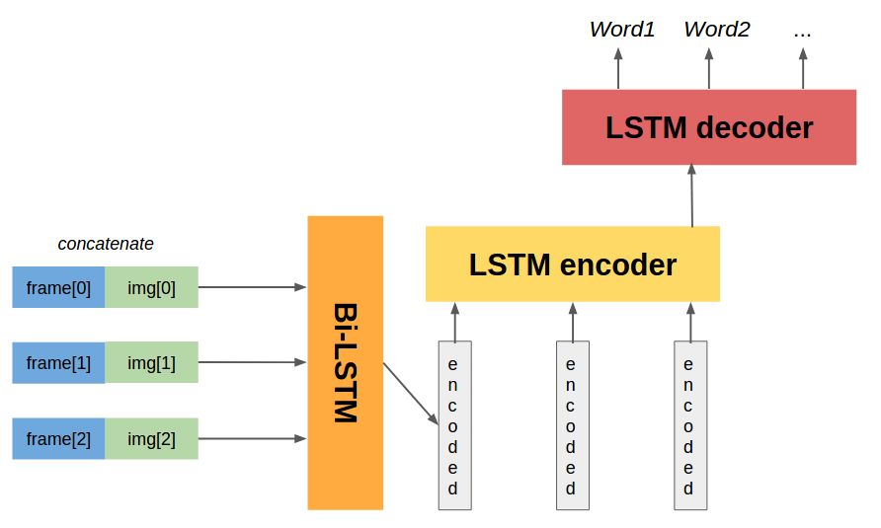
3 kinds of way
bi-LSTM to encode

Slide 18
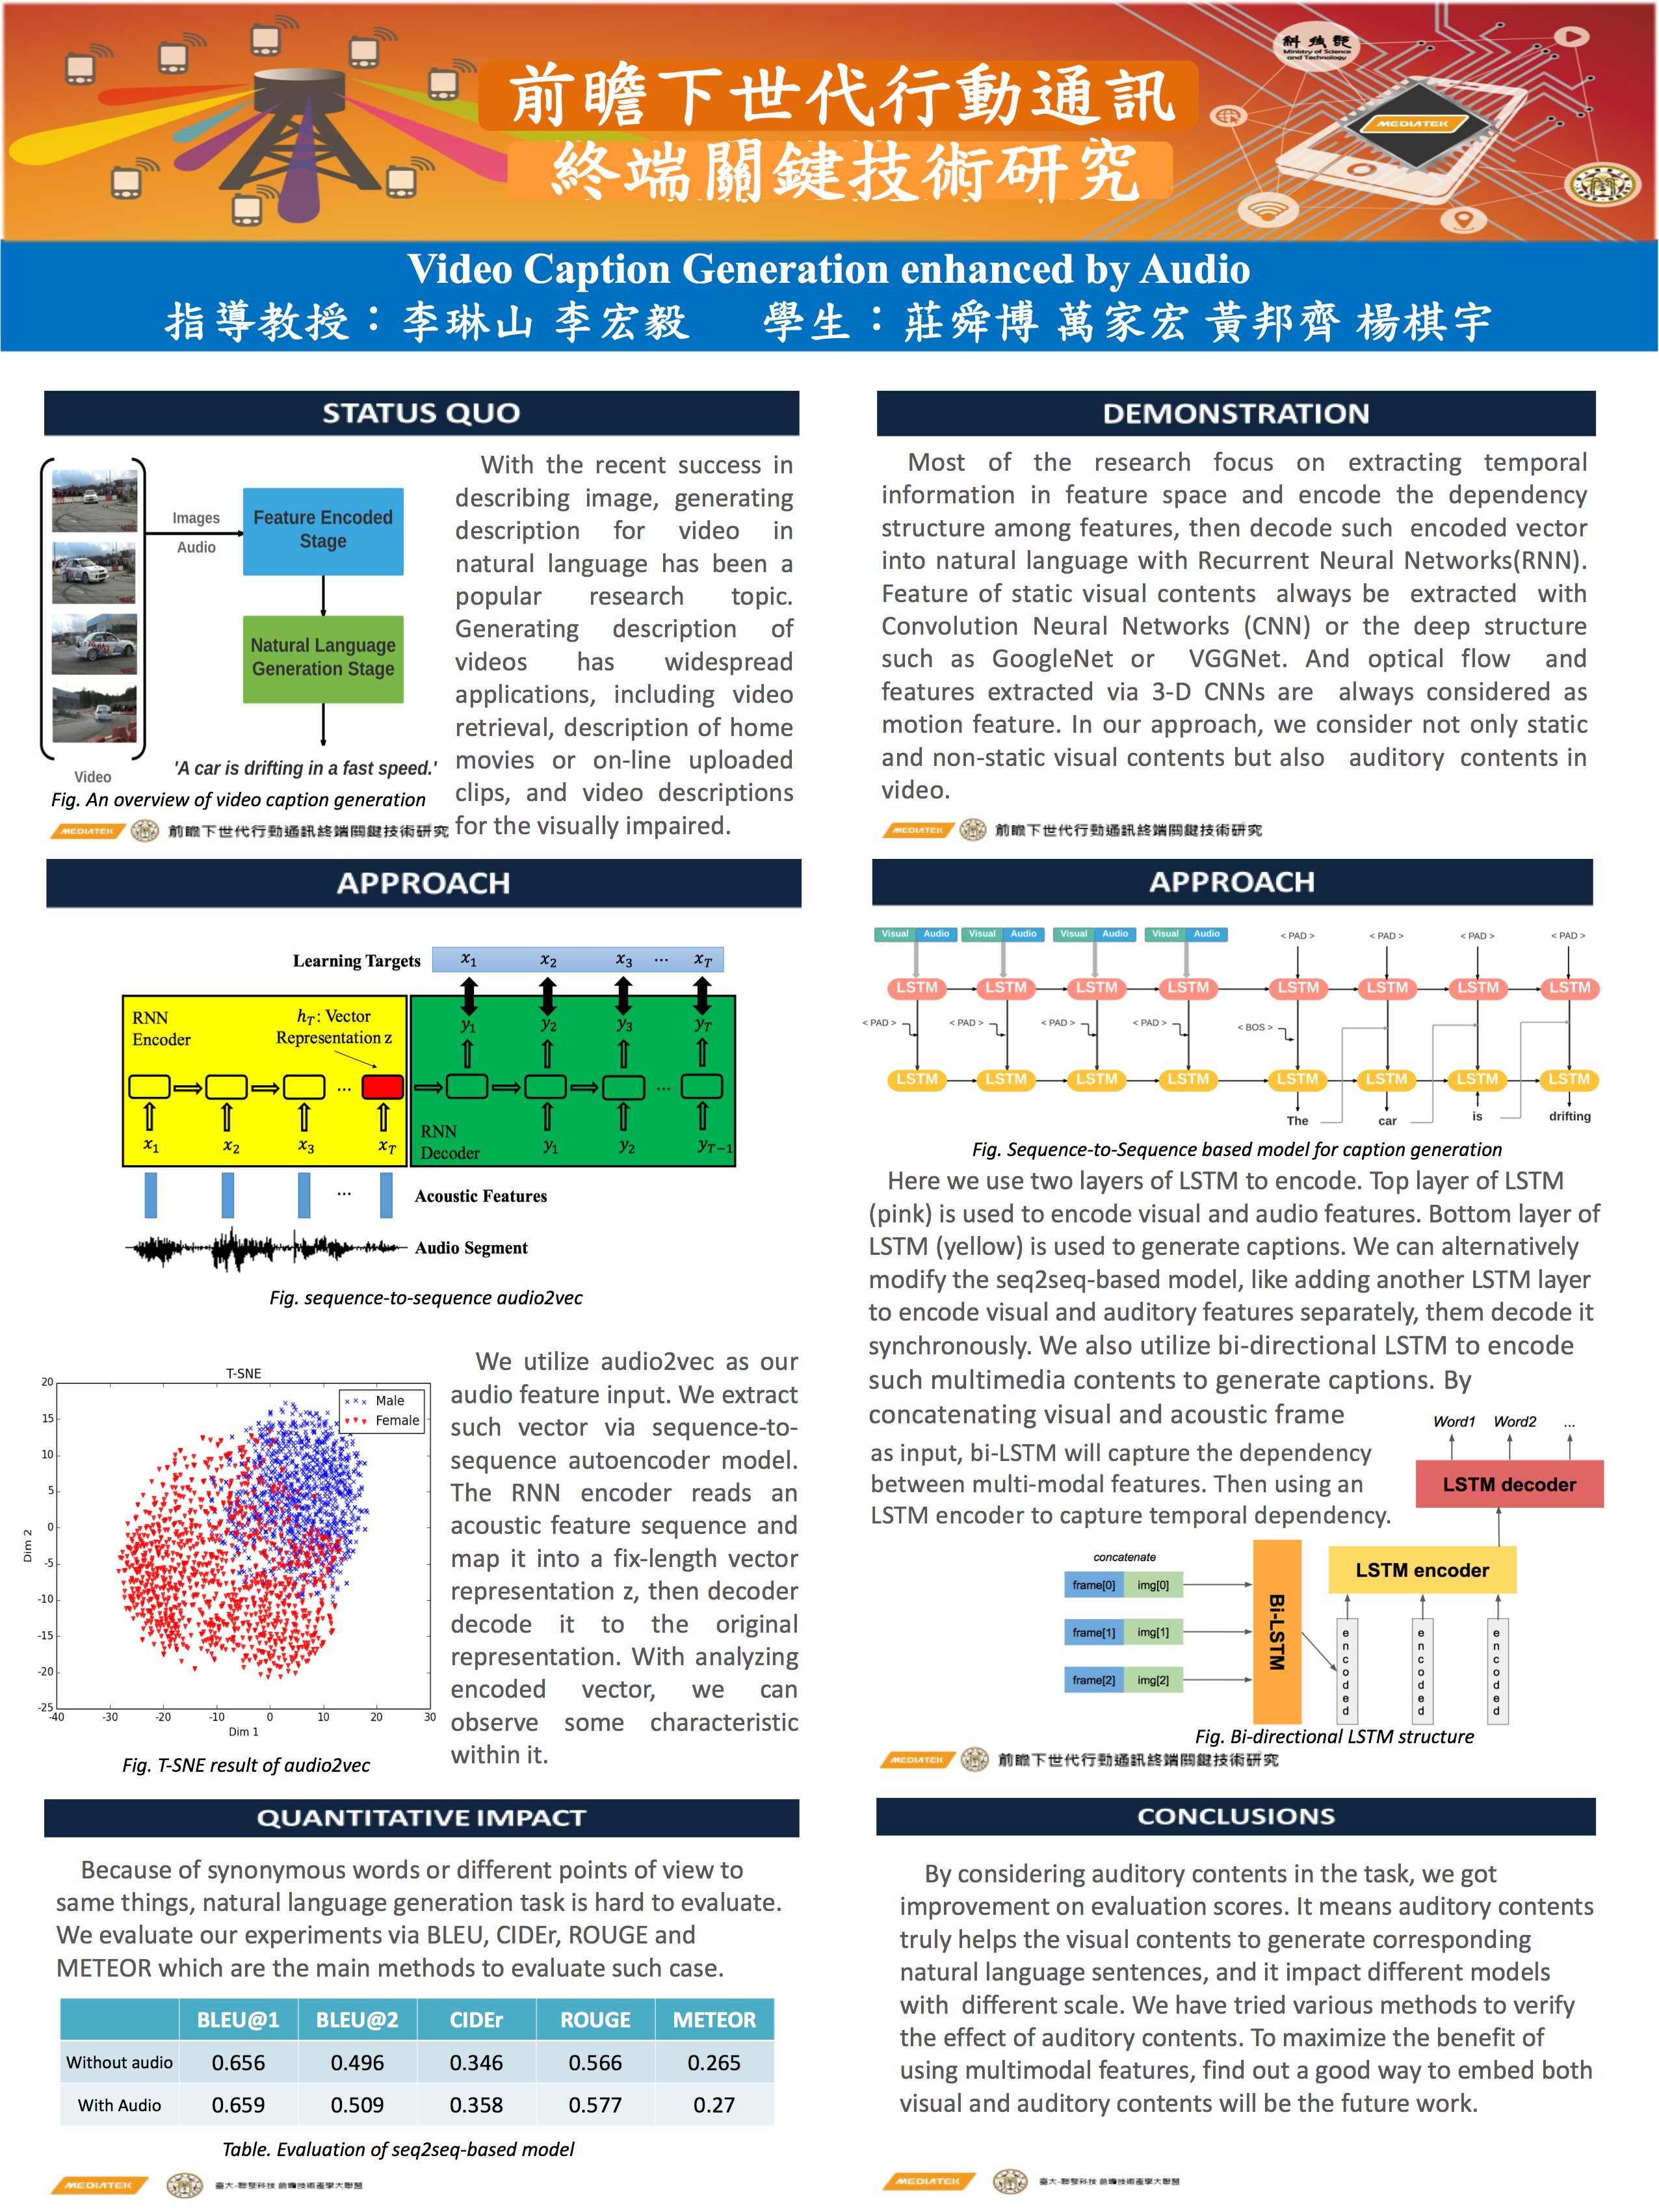
Reference
https://drive.google.com/file/d/0B84FPTGOlaWFRlVVTGprU1cwZGs/view

Slide 19
Future work
Attention mechanism 1. https://arxiv.org/pdf/1502.08029.pdf 2. https://www.merl.com/publications/docs/TR2017-008.pdf
實作 1.without audio

